Slide 1
Analyzing Aadhaar dataset
using MapReduce
By
Nymisha Bandi
Sirisha Lakkireddy
Srujan Kadanur Viswanath

Slide 2
Motivation
Aadhaar is a 12-digit unique identity number that can be obtained by residents of India, based on their biometric and demographic data. It can be referred to as “SSN of Indians”. It is currently the world’s largest biometric ID system. Our goal is to
●To analyze if the currently available Aadhaar centers are sufficient to generate the aadhaar numbers for the entire country(India).
●Deduce the enrollment agencies that are least effective at the aadhaar identities generation.

Slide 3
Dataset Description
Aadhaar dataset :
Registrar, Enrollment Agency, State, District, Sub District, Pin Code, Gender, Age, Aadhaar Generated, etc.
Country -> State - > District -> Enrollment agencies -> Aadhaar generation.
Data Pre processing

Slide 4
Tools used
Mapreduce to obtain the count of identities generated for each state.
Mapreduce to obtain the count of identities generated by each enrollment agency
Mapreduce to sort the results to deduce the top 10 enrollment agencies with minimum identities

Slide 5
Population in each state versus the number of aadhaar identities generated - histograms

Slide 6
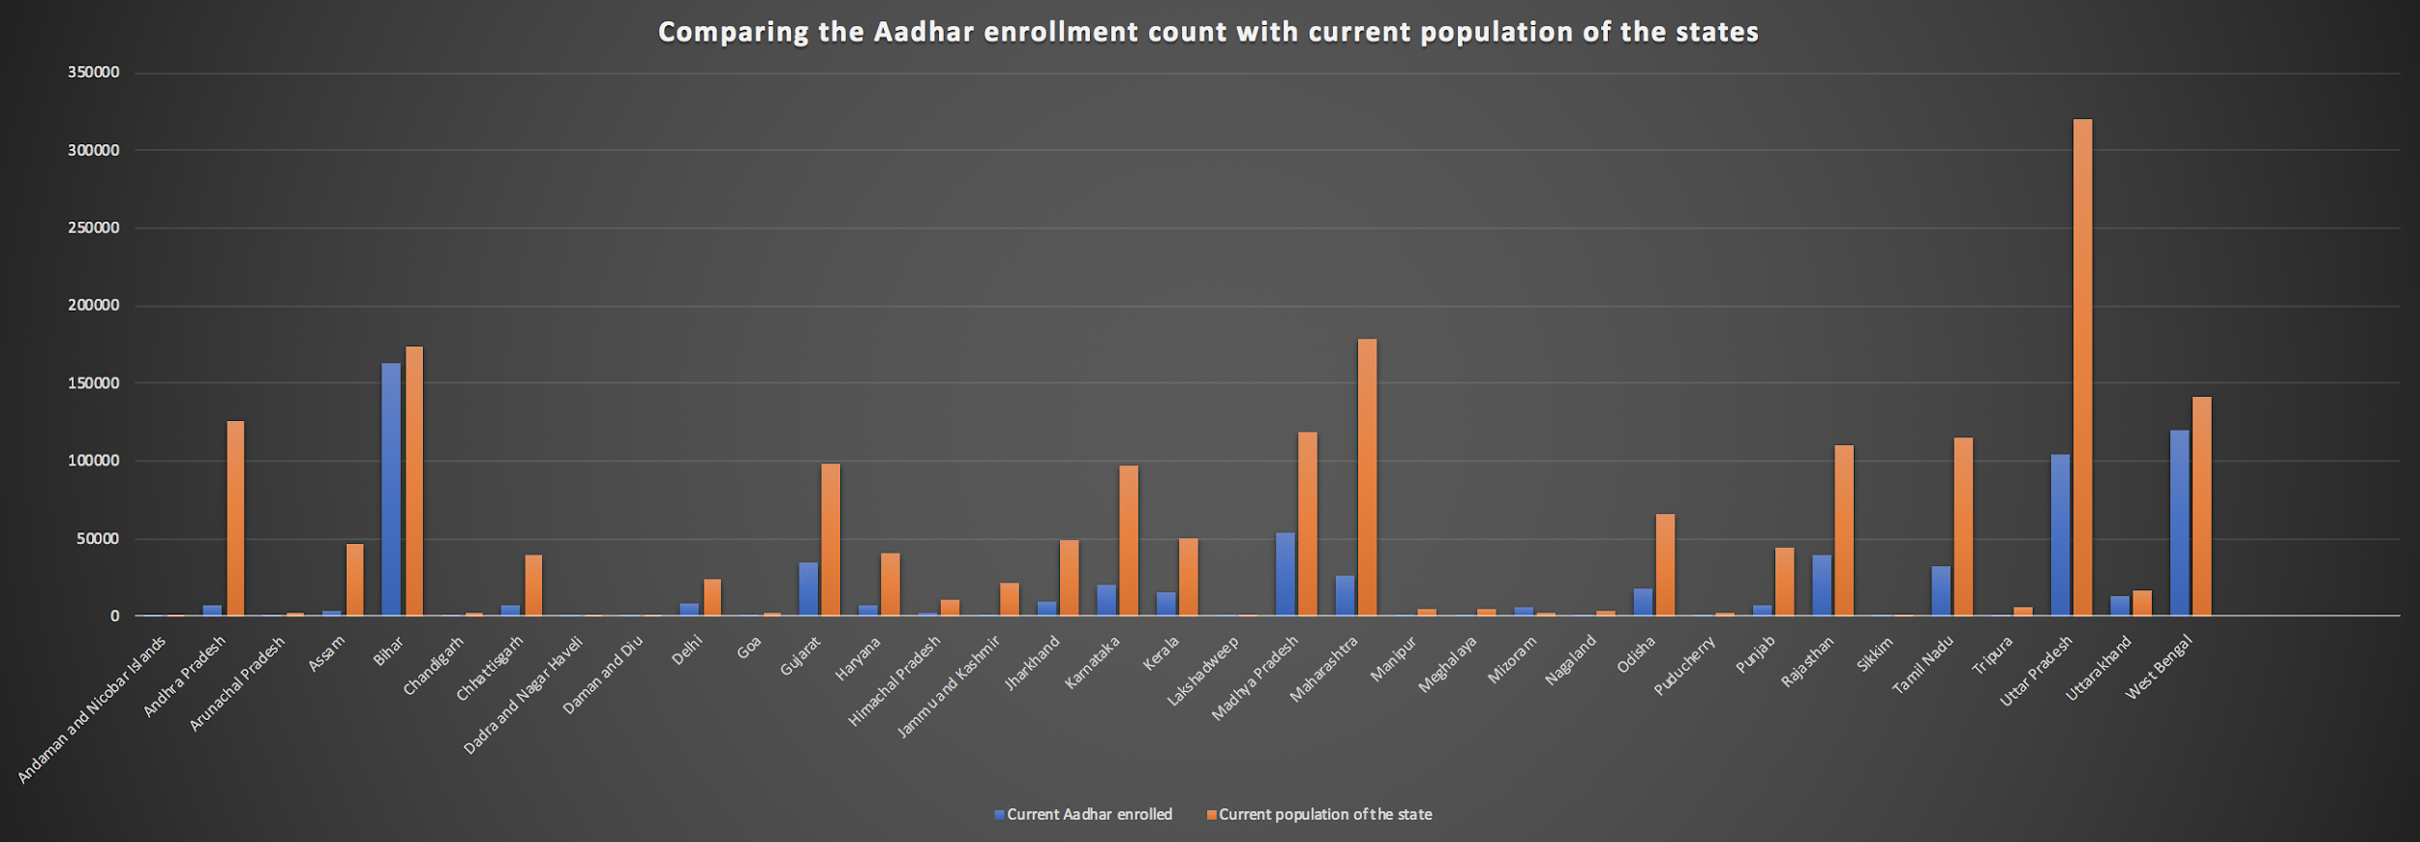

Slide 7
Enrollment Agency | Number of enrollments
District Family & Welfare Society Palwal | 0
District Family and Welfare Society Jhajjar | 0
District Health and Family Welfare Society Fatehabad | 0
District Sukhmani Society Amritsar Punjab | 0
DIT Lakshadweep | 0
SPANCO | 0
UNITED DATA SERVICES PRIVATE LIMITED | 0
WEBEL | 0

